Slide 1

Pseudoalignment for Matagenomic Read Assignment
Xiyuan Jiang
Cong Peng

Slide 2
Outline
1. Introduction
2. Methods and results
3. Demonstration
4. Conclusion
5. Q&A

Slide 3
Outline
1. Introduction
2. Methods and results
3. Demonstration
4. Conclusion
5. Q&A

Slide 4
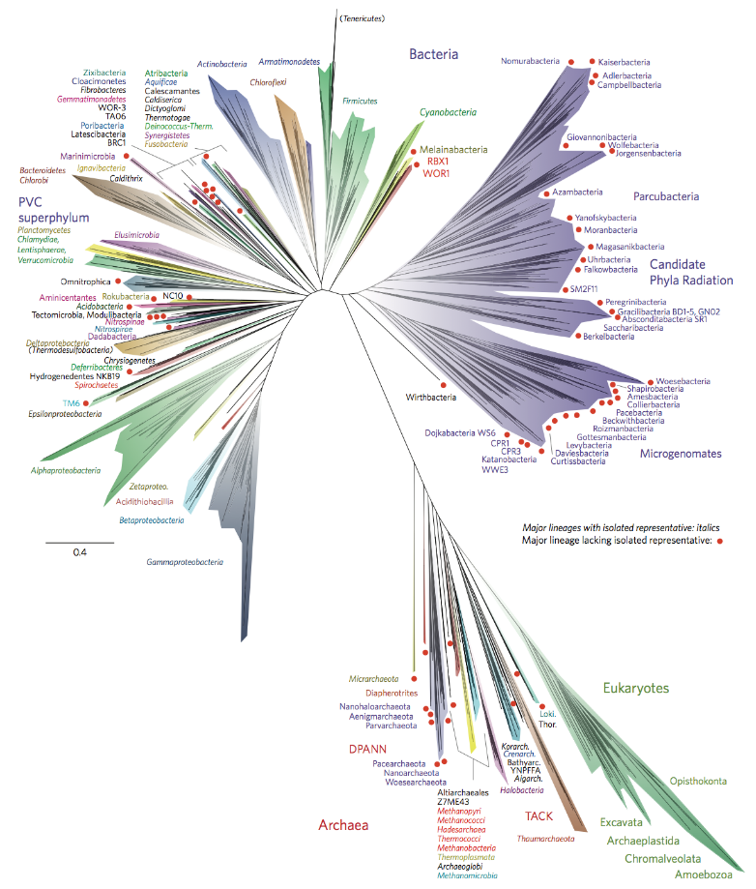
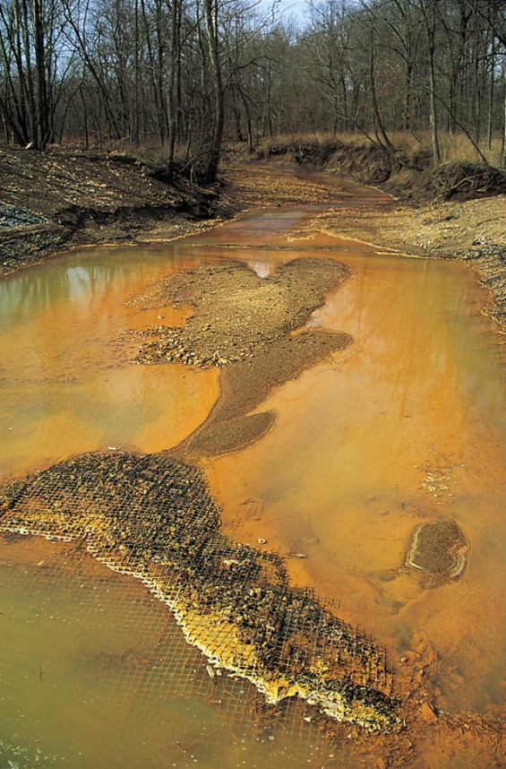
Introduction of metagenomes
Metagenomics is the study of genetic material recovered directly from environmental samples.

Slide 5

Introduction of metagenomes
Core problem: read assignment, assigning sequenced reads to taxa.

Slide 6
Metagenomics vs RNA-Seq
 | Metagenomics | RNA-Seq
Similarity | Assign genomic reads into a specific group
Difference | Map reads at a strain level Genomic sequences are larger Reference database less complete | Map read to a specific isoform Transcripts are relatively small Reference database well established
Notes:
There are many researches done in RNA-Seq, an experiment for which there has been extensive methods development that we hypothesized could be adapted and applied to metagenomics.

Slide 7
Apply RNA-Seq methodology to metagenomics
Origin: Statistical methods^{[1]} for identifying diﬀerential abundances in microbial marker genes were developed.
[1] Paulson, J. N., Stine, O. C., Bravo, H. C., and Pop, M. (2013). Diﬀerential abundance analysis for microbial marker-gene surveys. Nature methods, 10(12):1200–1202.
Notes:
The idea of translating RNA-Seq methodology to and from metagenomics was, to our knowledge, first proposed in

Slide 8
Programs comparison
Program | Pros | Cons
MEGAN^{[2]} | Assign reads to lowest taxonomic level Powerful visualization toolkit | Ambiguous mapping reads ignores individual strains Computation problem
Kraken^{[3]} | Instead of read alignment, k-mer hashing | Speed at a cost
Kallisto^{[4]} | More accurate Faster(“negligible”) | (currently not found in the paper)
Other related work: eXpress, CLARK, GASiC, GRAMMy……
[2]Huson, D. H., Auch, A. F., Qi, J., and Schuster, S. C. (2007). MEGAN analysis of metagenomic data. Genome research, 17(3):377–386.
[3]Wood, D. E. and Salzberg, S. L. (2014). Kraken: ultrafast metagenomic sequence classiﬁcation using exact alignments. Genome Biology, 15(3):R46.

Slide 9
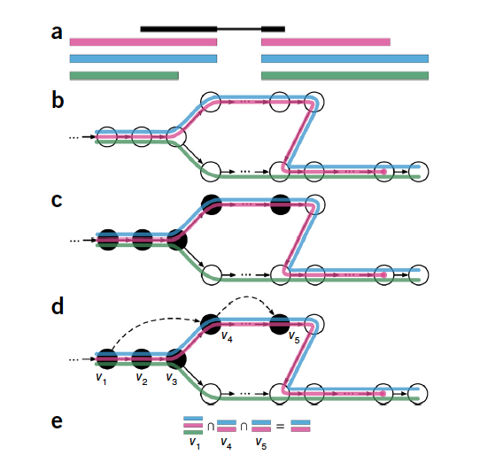
Pseudoalignment
Basic idea of kallisto (pseudoalignment)

Slide 10
Outline
1. Introduction
2. Methods and Results
3. Demonstration
4. Conclusion
5. Q&A

Slide 11
Methods and Results
1. Hypothesis test: RNA-Seq quantification can be applied in he metagenomics setting.
2. Performance evaluation: meta-kallisto performs better than state-of-the-art algorithms.

Slide 12
1. Hypothesis test
Hypothesis: RNA-Seq quantification methods can be applied in the metagenomics setting
Validation: Exam the performance of eXpress^{[1]}.
Reasons to choose:
a) eXpress utilizes traditional read alignments directly to a transcriptome.
b) eXpress is more memory efficient than other approaches.
[1] Roberts, Adam, and Lior Pachter. "Streaming fragment assignment for real-time analysis of sequencing experiments." Nature methods 10.1 (2013): 71-73.

Slide 13
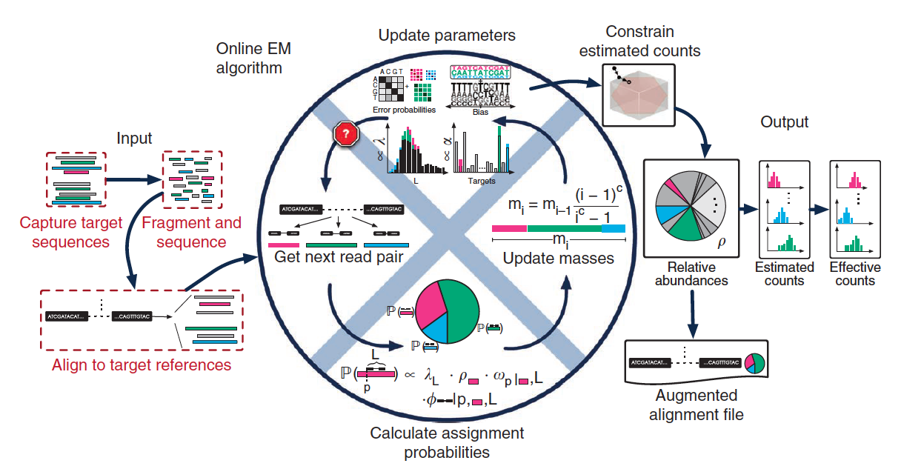
1. Hypothesis test
Overview of eXpress

Slide 14
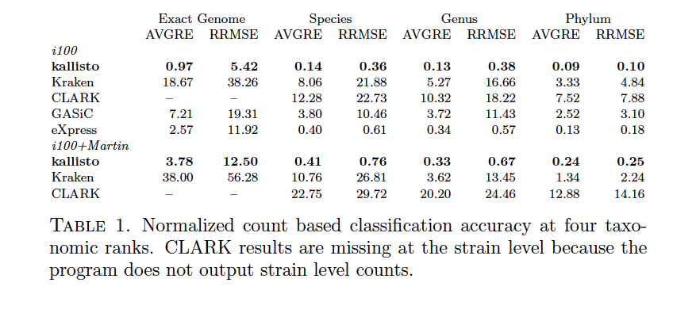
1. Hypothesis test
Dataset: Illumina-like reads from 100 microbial genomes to a reference database^{[2]} containing only those genomes.
Benchmark: GASiC, one method for utilizing read alignments for read assignment.
Taxonomic rank
low
high

Slide 15
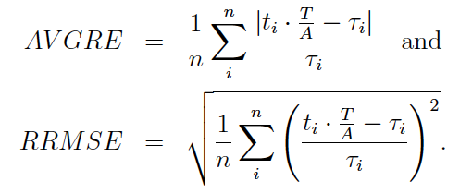
1. Hypothesis test
Note that:
n : number of true genomes/species/genera/phyla
τ_{i} : true counts
t_{i} : estimated counts
A : number of aligned reads
T : number of total reads

Slide 16
1. Hypothesis test
Dataset: Illumina-like reads from 100 microbial genomes to a reference database containing only those genomes.
Benchmark: GASiC, one method for utilizing read alignments for read assignment.
Taxonomic rank
low
high
Major problem for eXpress and GASiC: alignment SLOW!!

Slide 17
1. Hypothesis test
Benckmark: Kraken and CLARK
Taxonomic rank
low
high
Mini-conclusion: eXpress outperforms Kraken, GASiC and CLARK.

Slide 18
2. Performance evaluation
Algorithms to be compared: kallisto, Kraken and CLARK
A larger and more realistic reference database of 1,958 genomes

Slide 19
2. Performance evaluation
kallisto
Count
Kraken
CLARK
Psylum
Notes:
分图

Slide 20
2. Performance evaluation
kallisto
Count
Kraken
CLARK
Genus
Notes:
分图

Slide 21
2. Performance evaluation
kallisto
Count
Kraken
CLARK
Species
Notes:
分图

Slide 22
2. Performance evaluation
kallisto
Count
Kraken
CLARK
(No result)
Exact genome
Notes:
分图

Slide 23
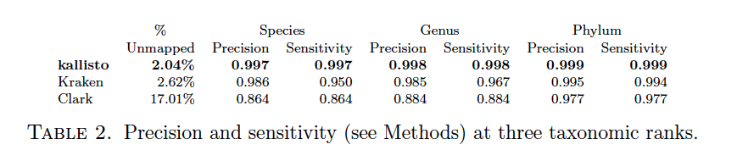
2. Performance evaluation
Algorithms to be compared: kallisto, Kraken and CLARK
A larger and more realistic reference database of 1,958 genomes

Slide 24
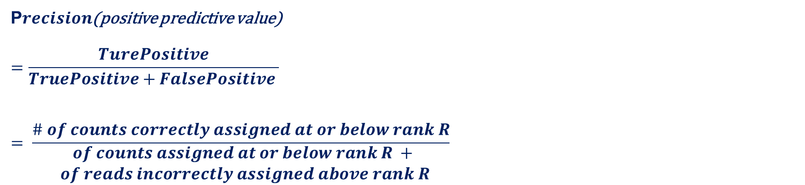
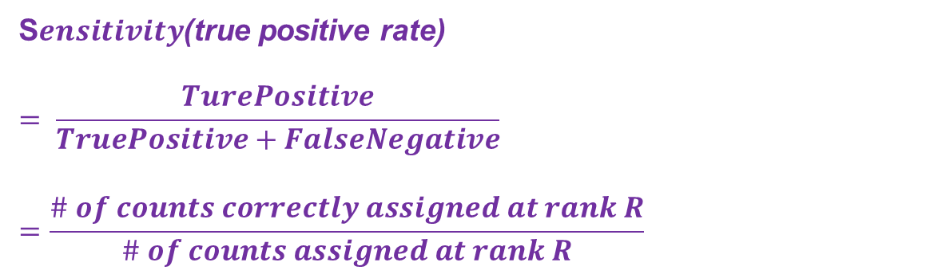
2. Performance evaluation
S$ensitivity$(true positive rate)
$$= \frac{TurePositive}{TruePositive+FalseNegative}=\frac{\# of counts correctly assigned at rank R}{\# of counts assigned at rank R}$$
P$recision$(positive predictive value)
$$=\frac{TurePositive}{TruePositive+FalsePositive }$$
$$= \frac{\# of counts correctly assigned at or below rank R}{\begin{aligned}\# of counts assigned at or below rank R + \\ \# of reads incorrectly assigned above rank R\end{aligned}}$$
[3]Langmead, B. and Salzberg, S. L. (2012). Fast gapped-read alignment with Bowtie 2. Nature methods, 9(4):357–359.

Slide 25
2. Performance evaluation
Then the cases of missing strains are examined.
A strain is missing but other similar strains are in the database: removed Bacillus cereus ATCC1 0987, leaving a number of other Bacilii.
A strain distant from others is missing: removed Listeria welshimeri serovar 6b str. SLCC5334, leaving no other Listerias.

Slide 26
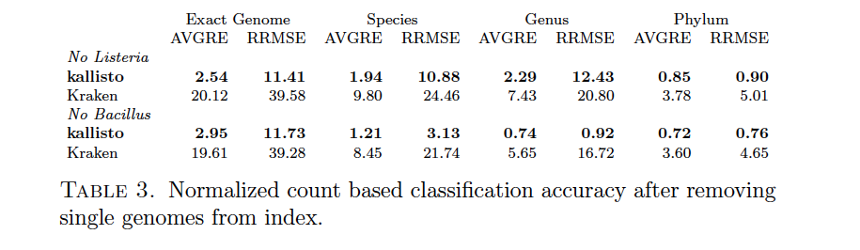
2. Performance evaluation
Then the cases of missing strains are examined.

Slide 27
Outline
1. Introduction
2. Methods and Results
3. Demonstration
4. Conclusion
5. Q&A

Slide 28
Flowchart
Simulated metagenomic data
Kallisto
transcripts/genomes and their relative abundance
Comparison script
Results: sensitivity, precision, etc.

Slide 29
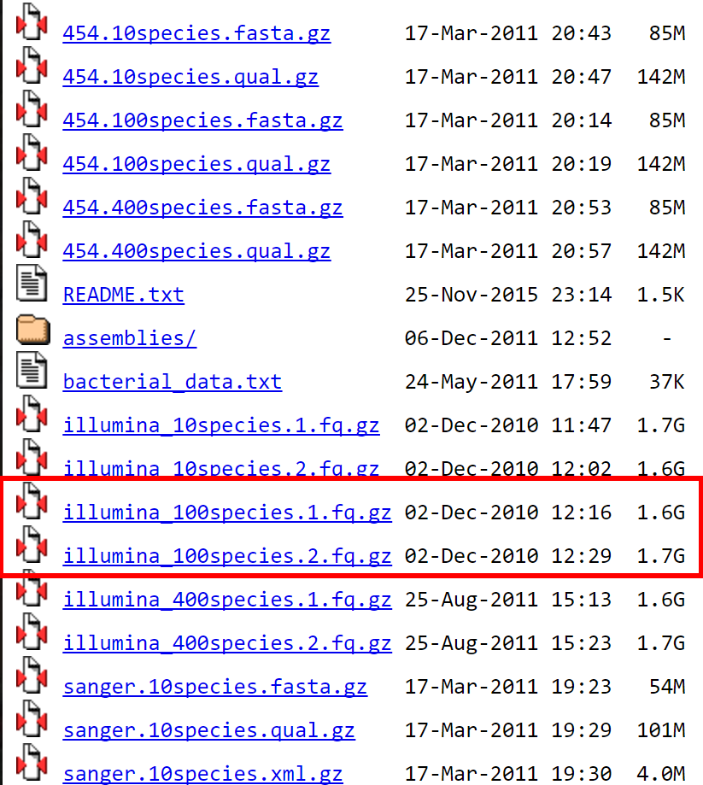
Data simulator
iMESS_Illumina
https://sourceforge.net/projects/cmessi/
Used to generate Illumina100 dataset
Mende D R, Waller A S, Sunagawa S, et al. Assessment of metagenomic assembly using simulated next generation sequencing data[J]. PloS one, 2012, 7(2): e31386.
Notes:
cMESSi: A metagenomic simulator for the Illumina sequencing technology
We contacted the author, and he used the available data as well

Slide 30
Outline
1. Introduction
2. Methods and Results
3. Demonstration
4. Conclusion
5. Q&A

Slide 31
RNA-Seq methods for quantiﬁcation are also applicable in the metagenomics setting.
It is possible to accurately and rapidly quantify the abundance of individual strains.
The door is now open to metagenome analyses at the highest possible resolution.

Slide 32
The lack of attention paid to low taxonomic level analysis.
Spur others to standardize and organize naming conventions.

Slide 33
Outline
1. Introduction
2. Methods and Results
3. Demonstration
4. Conclusion
5. Q&A

Slide 34
Question lists
Q1. In order to test the hypothesis that RNA-Seq can be applied on metagenomics setting, the author examined eXpress, why they also compared the results of eXpress with GASiC?
A1. As we know, the author ran eXpress program to test the hypothesis mentioned before. It is clear that eXpress is a program for RNA-Seq, while GASiC is a program for metagenomics analysis. In the first approach, the author evaluated the result of eXpress on metagenomics, and it turned out to be better than GASiC, which means that hypothesis is thus comfirmed.

Slide 35
Question lists
Q2. What is the meaning of ‘exact genome’ in terms of taxonomy?
A2. Across the paper, there are four taxonomic ranks, phylum, genus, species, and “exact genome” level. The exact genome is actually not a well-defined rank, which is a combination of strains and substrains. The purpose of adding this rank is because this paper wants to test the performance of killasto and other algorithms in high taxonomic resolution.

Slide 36
Question lists
Q3. In the computation of AVGRE, what’s the meaning of T/A in the expression?
A3. See blackboard.

Slide 37
Question lists
Q4. What is the reason for not be aliened.
A4: Species not known, cannot sequence. Particularly true for metagenomics.

Slide 38
Question lists
Q5. Why are counts considered correctly assigned when they were less than or equal to true counts? What’s the logic in it?
A5: If the estimated counts are larger than the true counts, it is not correct.
05/17/17
38

